Slide 1
Chapter 4
Process Modeling
This chapter introduces techniques for modeling business processes with roles, activities, and interactions.
It covers:
Business Behavior Model
  Activity diagrams
  State diagrams
Supporting Business Information Model
[Optional] Defining a reference business process architecture

Slide 2
Preview of Business Architecture
Domain Subject Matter Expertise
Domain descriptions and standards
Knowledge of (and in) existing systems
Operating procedures
2
3
Information Model
Goals Model
Process/Subject area 1
Behavior Model
g1
g2
g3
Roles
User
Business
Architect
Application
Architect
Types, attributes and associations
(Without “operations”)
Goals, sub-goals,
assumptions
Activity diagram:
Roles, activities, interactions, states
Dictionary, Snapshots, End-to-end scenarios, textual specification
Optional: description relating attributes, actions, events across multiple process or subject areas
Why do a Business Architecture?
To get a clear definition of business rules and target business model, define the ultimate requirements for the project, and document that model in a form that serves downstream work.

Slide 3
Steps to Business Architecture
Reference: CAM PDF, page 9; links to steps and techniques. More being added e.g. goal models.
Goal model: Define stakeholders, goals, explore why and how of goals for completeness
Scenarios: Find outer boundary of the problem to define end-to-end scenarios
  As far out in “space” and in “time” to include the real goal that must be met
  Use these to validate business goals and process models
[Optional] As-Is model: If appropriate, start with As-Is Process
  Define as-is processes based on current practice
  Identify stakeholder roles and their goals and CTQs (Critical-to-Quality attributes) for the process
    Zoom out of detailed activities to larger grained ones and to more black-box views
    What are post-conditions? What matters to Stakeholders? What are CTQ (Critical to Quality) attributes (goals)? How are the goals structured?
  Analyze the as-is model, particularly with respect to CTQs
    Identify failures, overlaps, redundancies, non value-adds, etc. and their causes
    Inadequate resource co-ordination across multiple “cases”, business rule failures, process defects
  Define Essential (“reference”) Process architecture (explained later)
To-Be model: Brainstorm the To-Be Process using the above goals and as-is models
  If you design multiple processes, also include an overview of how they interrelate
  Define Information Model as needed to support activities in process and goals model
Why?
  Use goals and understanding of current-state to design future-state business process

Slide 4
Example of Boundary, Stakeholders, CTQs
What is the outer boundary for the Dental Practice?
  Patient? Patient’s family? Patient’s employers?
What are largest grained actions there? Finer grained ones?
  Patient lifecycle, visit the dentist, sign in / get treated / pay
  End to end scenario start from entire patient lifecycle → complete visit → make appointment
Who are all the stakeholders, how to group them, and what are their goals and CTQs?
  Routine Patients
    Want more proactive planning of appointments for dental care and follow-up
    Would like reminders of appointments with option to change times
    Need appointments scheduled and completed efficiently, with access to medical history, cost and insurance coverage information, and suitable or preferred dentist or staff assigned
  Emergency Patients - to be seen immediately
  Insurers - Want justification and audit trail for each treatment
  Dental Practice – Increase patient satisfaction, faster billing, fewer questions from insurance
Failures, deficiencies, etc.
  Appointments changed or cancelled due to patient’s personal schedule
  Appointments changed or cancelled due to dentist becoming unavailable
  Appointments forgotten by patient
  Patient care suffers when pre-planned appointments not consolidated with new symptoms
  Better follow-up planning and scheduling possible

Slide 5
Business Behavior Model – Activity Diagrams
A scenario is a concrete story of an interaction sequence. An Activity Diagram specifies required interaction sequences, and generalizes scenarios. This section covers:
Describing Business Process with an Activity Diagram
  We will include some facilities supported by the new UML 2.0

Slide 6
Activity diagram Generalizes End-to-End Scenarios
Process: Patient Visit
Goal: Patient has made appointment, completed visit, and all charges have been billed
Patient
Patient Assistance
Dentist
Billing
make
Scenario name: joe visits dentist for annual cleaning and checkup
Initial state: joe is already a patient at teeth’r’us.
His account is in good standing.
    He has has no pending treatment.
1: joe calls and schedules an appointment with dora for 5/1
2: At the appointment time, joe signs in at teeth’r’us
3: dora works on joe and does his cleaning and x-rays; all clear.
4: joe pays his co-payment and teeth’r’us bills his insurance
Final state: joe is treated, and his dental and account records are updated and his insurance billed
appointment
colored
appointment is confirmed
red
black
green
change
appointment
appointment
date
Note: cannot change
after appointment date
sign in
treat patient
bill
make co-
insurance
pay

Slide 7
Activity Diagram Explained
Process name and goal
Process: Patient Visit
Initial state
Goal: Patient has made appointment, completed visit, and all charges have been billed
Role
(Partition)
Initiator
Interaction / Joint Activity: both pre-states must be enabled.
No arrow. Our convention: name from (shaded) initiator end
Final state
State
(can be on line ends in or out of activity)
Patient
Patient Assistance
Dentist
Billing
make
Branch (with conditions, only one gets enabled)
appointment
colored
appointment is confirmed
Fork (all outs enabled in parallel)
[red]
[black]
[green]
Signal/
Event
Merge (any one can enable)
change
appointment
raise
event
appointment
date
Raise event
sign in
Activity
(= Action)
treat patient
Join (all ins must be enabled)
Sequence
Sequence
(arrow)
bill
make co-
insurance
pay

Slide 8

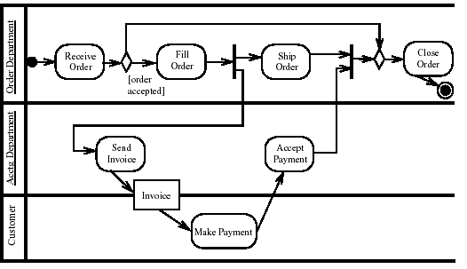

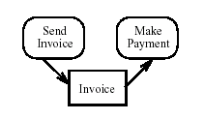
Preview of some UML 2.0 Differences
UML 2.0 uses “Rounded Rectangle” for action and activity
UML 2.0 “Partition” can indicate role, or other grouping of activities
UML 2.0 does not allow Interactions / Joint Activity on graphical “Partitions”, but text-annotation version allows “partition” list per activity.
This action is contained within 2 partitions e.g. jointly performed by 2 roles
UML 2.0 has “Object flows” for state, “Interruptible” regions, “pins”, and more
Object flow

Slide 9
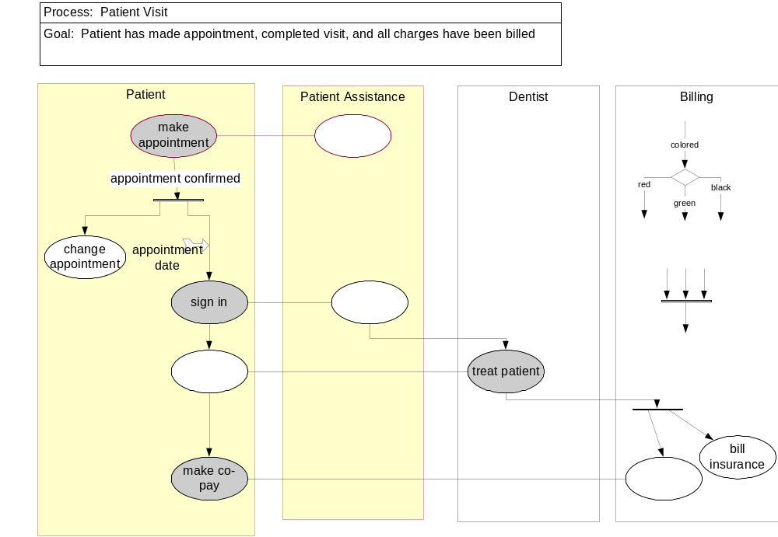
Activity Diagram Pragmatics
Note: the patient can change the appointment anytime many times before appointment date
Formalizing concurrency, iteration, conditionals… can make diagram detailed
Can simply add annotations to the activity diagram explaining these cases
  Let the diagram focus on being clear about the “normal case”
  Annotation on diagram, or numbered footnotes
Compress detailed conditions using names like “do xyz if appropriate”

Slide 10
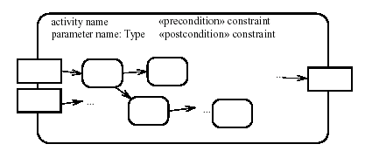
Textual Activity Specification
UML 2.0 composite activity with pre/post + explicit in/out parameters using object flows
Actions specified textually
  activity: make appointment
  roles: Patient, Patient Assistance
  inputs: symptoms: Set of Symptom [from Patient]
  outputs: appointment details: Appointment [to Patient]
  Precondition: Patient account is not delinquent
  Postcondition: An appointment has been created for
  patient for date, to cover planned treatments, with dentist qualified for treatment type.
  Insurance and cost estimates recorded.
As always, this (together with state annotations on diagram) uncovers terminology and states needed in the Information Model
Dentist
Appointment
confirmed: Boolean
when: Date
qualified dentists
Treatment
cost estimate
insurance estimate
Treatment Type
plan

Slide 11
Model granularity – Expand Roles and Activities
Dental
Practice
Dental
Practice
Patient
Insurance
make
appointment
Patient
Insurance
Patient
visit
Expand activity or
interaction
treat
pay
Expand role
Insurance
Patient
Patient Dentist Billing
Assistance
Any activity can be expanded into finer grained activity or interaction
Any role can be expanded into a more granular set of roles
An entire process can be treated as a single action
“Black box” and “white box” is equally applicable in business modeling
Start with largest grained activities and roles, be willing to zoom in and out

Slide 12
Exercise 5.1

Slide 13
Essential Business Process Architecture
This section covers:
Large domains have multiple interrelated business processes
Case and Case Coordination gives one clear structure across processes

Slide 14
Essential Process Architecture with Example
Find “essential” business entities: interesting lifecycles, you cannot imagine not having
  “Essential” entities: Patient, Visit, Dentist, Payment
Find “generates” relations to other entities spawned off, with their own lifecycles
Define a “case” process: takes each instance through entire lifecycle e.g.make loan, order
Define a “case coordination” process to start, stop, coordinate across multiple “cases”
Define a “case strategy” process to evolve both case and case-coordination processes
  Maintain Patient, Coordinate Patients
  Patient Visit, Coordinate Visits
  Employ Dentist, Coordinate Dentists
Process architecture relates these together with summarized interactions
case process
Patient Strategy
case coordination process
Maintain Patient
onboard,
retire,
allocate rep
Maintain Patient
Coordinate Patients
visit request
Coordinate Dentists
hire,
fire,
co-ordinate vacations
Maintain Patient
deliver visit
Employ Dentist
Maintain Patient
new visit,
re-schedule
Patient Visit
Coordinate Visits

Slide 15
Business Behavior Model – Lifecycles
This section covers:
Describing Object Lifecycle using a State Diagram and State Matrices

Slide 16
State Model Describes Lifecycle of Object
Frequently, some objects in the domain have complex lifecycles
  Insurance Company: a Claim
  Pharmaceutical Company: a candidate Drug, a Clinical Trial
  Financial Services: a Syndicated Loan
  General Business: an Opportunity
Question: Which of our activity diagrams represents such a “case” process?
Such objects progress through an interesting state progression
  Insurance Claim: filed, appraised, contested, in court, settled
  Pharmaceutical Drug: in lab trials, in clinical trials, in sample production, FDA approved
  Trade: modeled, approved, executed, booked
A State Model shows states and transitions between states of such objects
  Each state is represented by one Boolean attribute (or other status attribute)
  Each state corresponds to some combination of other attributes and associations
  The transitions correspond to the completion of actions and activities

Slide 17
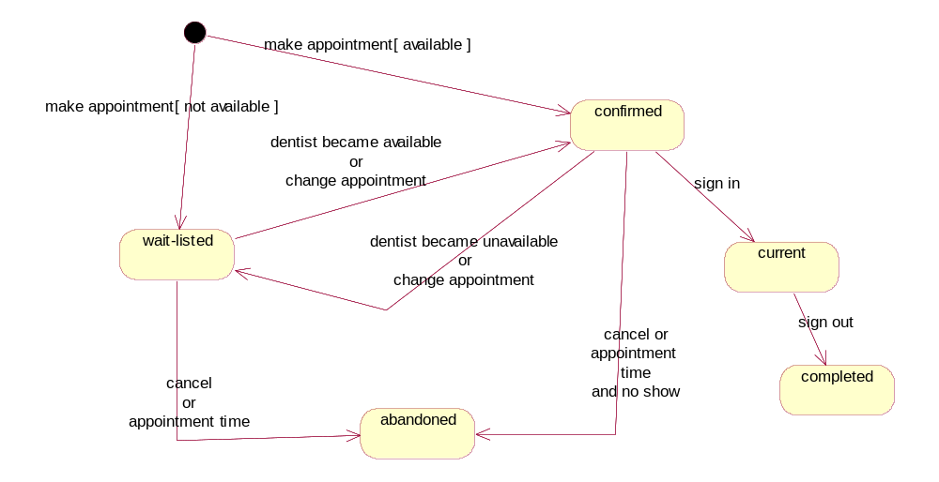
State Diagram of Dentist Appointment
Note: activity diagram is a dual of a state diagram: bubbles as actions Vs. bubbles as states
event = action (completion)
guard = condition
Object not yet existing
(“initial state”)
state
States: confirmed, wait-listed, current, abandoned, completed
Events: make appointment, change appointment, sign in, …

Slide 18
State Definition Table and State-Event Table
Each state is equivalent to a Boolean attribute (or some “status” attribute)
Each state should be derived from other attributes and associations
A simple table (matrix) of states vs. other attributes and associations can be helpful
State | Derivation Expression
confirmed | time > now and dentist <> null
wait-listed | time > now and dentist = null
current | time = now and signedIn
Each transition event should correspond, directly or indirectly, to some action
All events should be considered in all states
A simple table of states vs. possible events helps find missing cases
State → Event ↓ | confirmed | wait-listed | current
Change appointment | Confirmed, wait-listed | Confirmed, wait-listed | NA
Dentist available | Confirmed | Confirmed | NA
Dentist unavailable | Wait-listed | Wait-listed | NA
Time out | Abandoned | Abandoned | NA

Slide 19
Exercise 5.2

Slide 20
Business Architecture – Some Guidelines
Focus on end goal and state change for every process or activity
Distinguish black-box from white-box views of processes
Support process behaviors and goals with information model
Zoom in and out of processes, activities, and goals
[Optional] Define reference process architecture from object lifecycles

Slide 21
Summary
This chapter has shown that:
Activity diagrams and state diagrams provide complementary views of behavior
A reference business process can be systematically derived
Modeling business goals uncovers assumptions, alternatives, rationale

